Slide 1
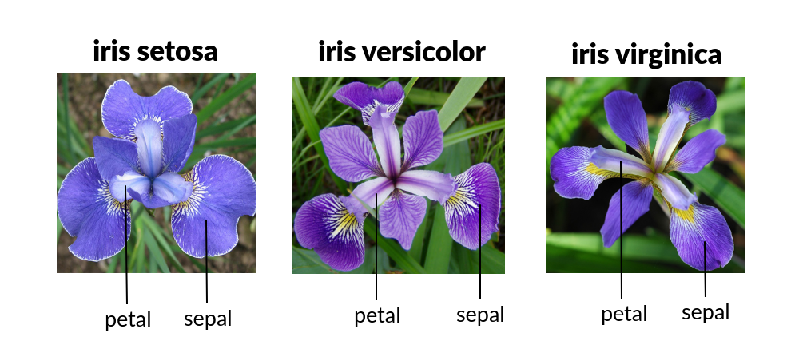
Iris Dataset Analysis
Name :- Vrunda Khedkar
Batch ID :- EBEON1021460120

Slide 2
Contents
Dataset Information
Objectives
Introduction
Flow Chart
Data Set
Exploratory Data Analysis
Tools and Technology
Reference

Slide 3
Dataset Information
This data set consists of the physical parameters of three species of flower — Versicolor, Setosa and Virginica.
The numeric parameters which the dataset contains are Sepal width, Sepal length, Petal width and Petal length.
In this data we will be predicting the classes of the flowers based on these parameters.
The data consists of continuous numeric values which describe the dimensions of the respective features.
We will be training the model based on these features.

Slide 4
Objectives
Given the sepal length, sepal width, petal length and petal width, classify the Iris flower into one of the three species — Setosa, Virginica and Versicolor.

Slide 5
Introduction
The Iris flower data set consists of 50 samples from each of three species of Iris Flowers — Iris Setosa, Iris Virginica and Iris Versicolor.
The Iris flower data set was introduced by the British statistician and biologist Ronald Fisher in his 1936 paper “The use of multiple measurements in taxonomic problems”.
Iris data is a multivariate data set.
Four features measured from each sample are —sepal length, sepal width, petal length and petal width, in centimeters.

Slide 6
Flow Chart
Statistical Computation of Iris Flower Data
Statistical Computation of Iris Flower Data
Statistical Computation of Iris Flower Data
Analyzing Data Visually
Analyzing Data Visually
Collect the Iris Flower Data
Analyzing Data Visually
Collect the Iris Flower Data
Collect the Iris Flower Data
Testing and accuracy of the model
Training of the model
Dividing the data for training and testing

Slide 7
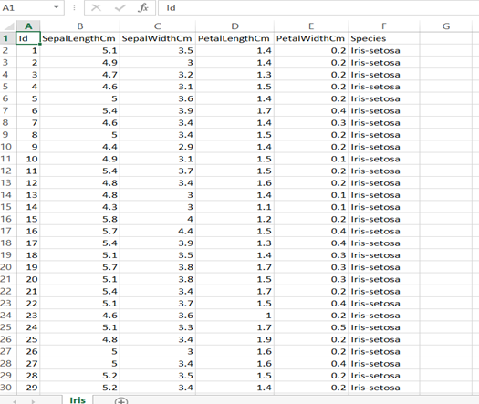
Dataset

Slide 8
Methodology
Import Libraries
Load the dataset
Dataset Information
Perform Statistical Information
Preprocessing the Dataset
Perform Exploratory Data Analysis
Preparing data for training model.
Split the data into train and test data.
Use ML Algorithm
Dashboard.

Slide 9
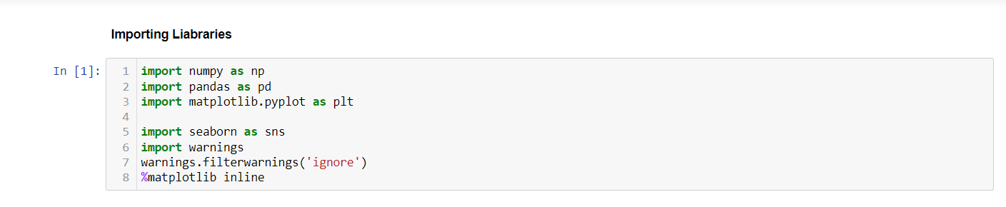
1. Import Libraries

Slide 10
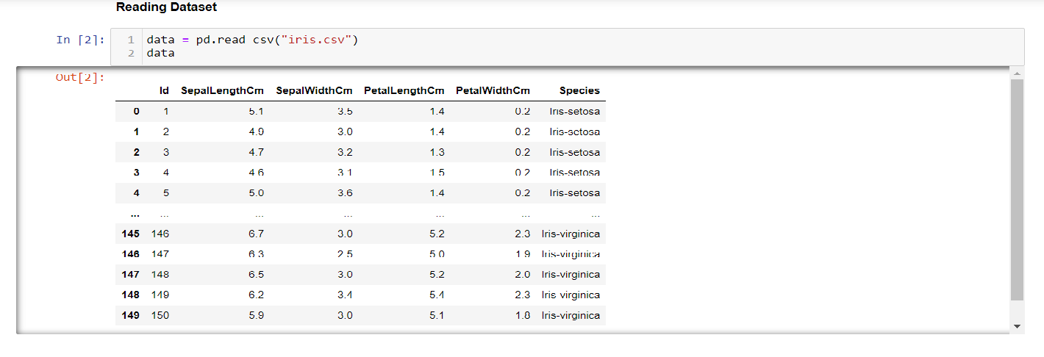
2. Load the dataset

Slide 11
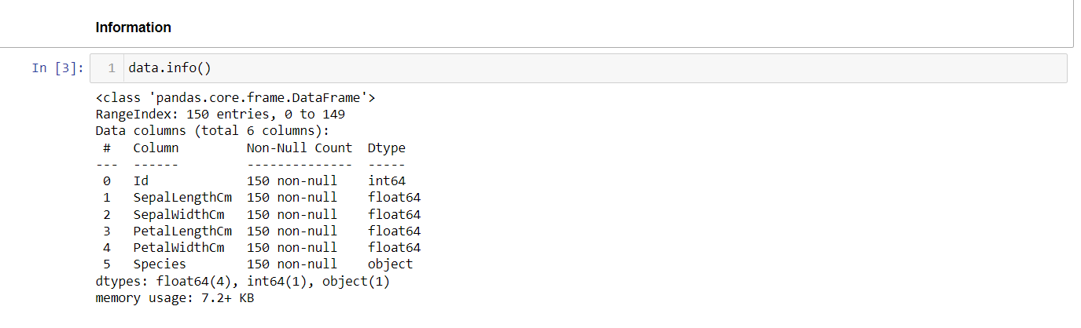
3. Dataset Information

Slide 12
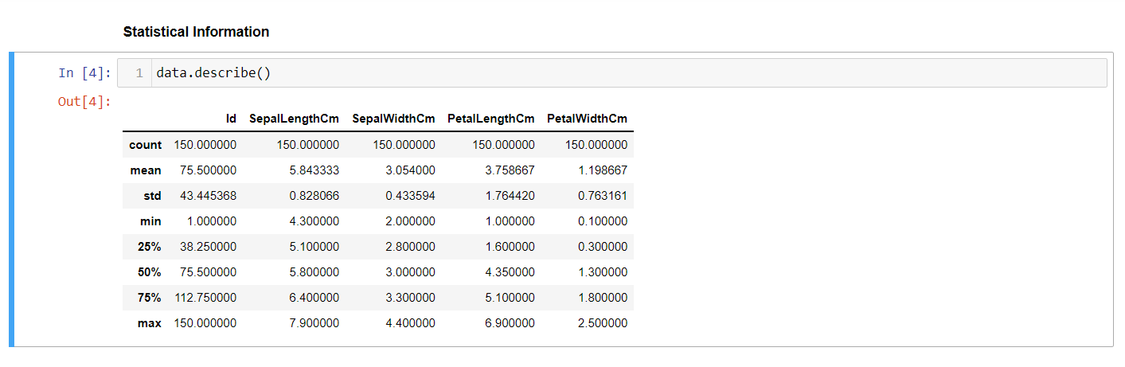
4. Perform Statistical Information

Slide 13
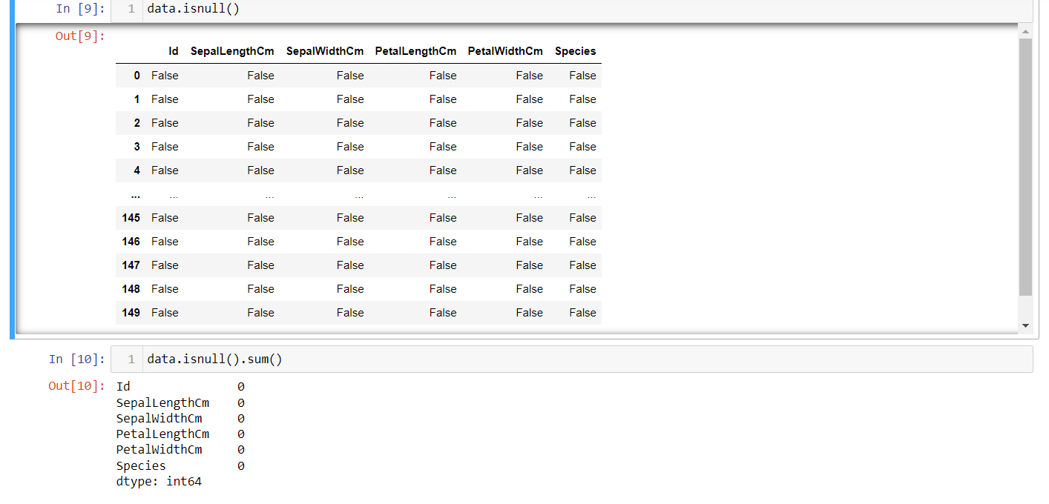
5. Preprocessing the Dataset

Slide 14
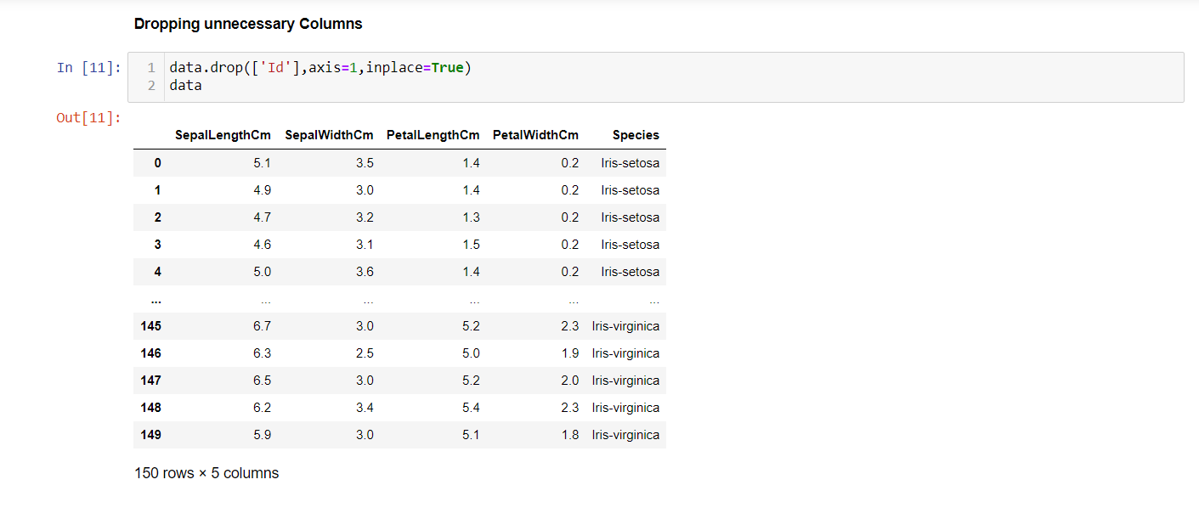
Continue..

Slide 15
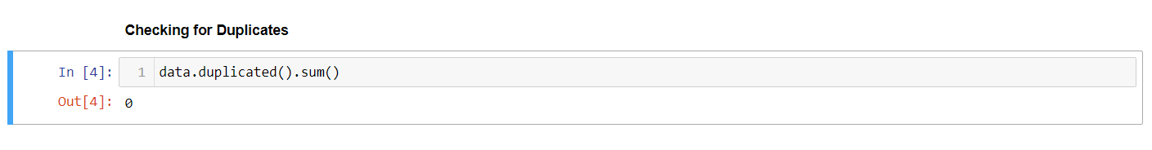
Continue..

Slide 16
6. Exploratory Data Analysis on Iris Dataset
Exploratory Data Analysis (EDA) is a technique to analyze data using some visual Techniques.
With this technique, we can get detailed information about the statistical summary of the data.
We will also be able to deal with the duplicates values, outliers, and also see some trends or patterns present in the dataset.

Slide 17
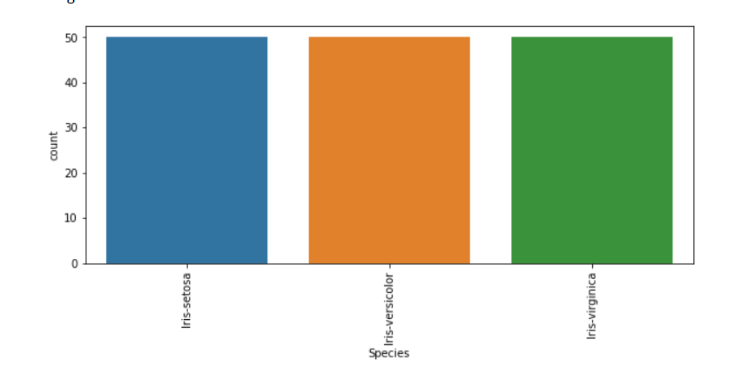
Continue
plt.figure(figsize=(16,5))
print(data['SepalLengthCm'].value_counts())
plt.figure(figsize=(10,4))
sns.countplot(x=data['Species'])
plt.xticks(rotation=90)
plt.show()

Slide 18
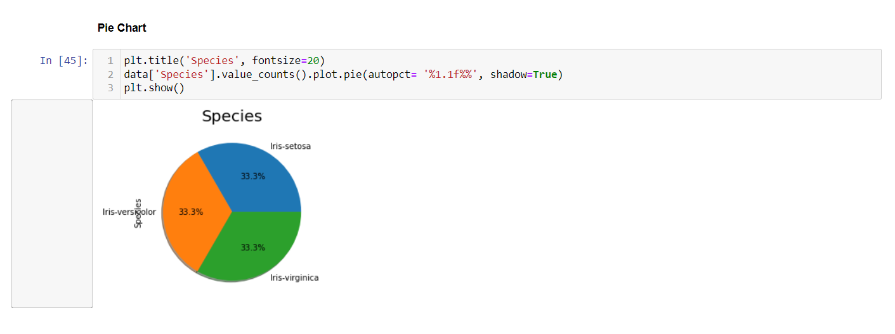
Continue..

Slide 19
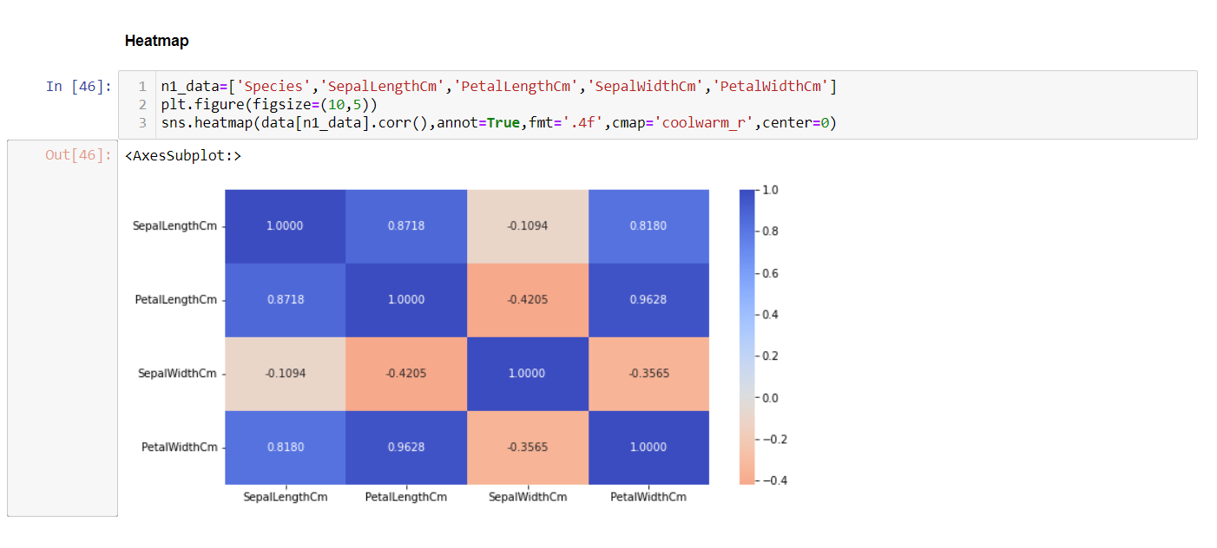
Continue
The heat map is a data visualization technique that is used to analyze the dataset as colors in two dimensions. Basically, it shows a correlation between all numerical variables in the dataset.
Petal width and petal length have high correlations.
Petal length and sepal width have good correlations.
Petal Width and Sepal length have good correlations.

Slide 20
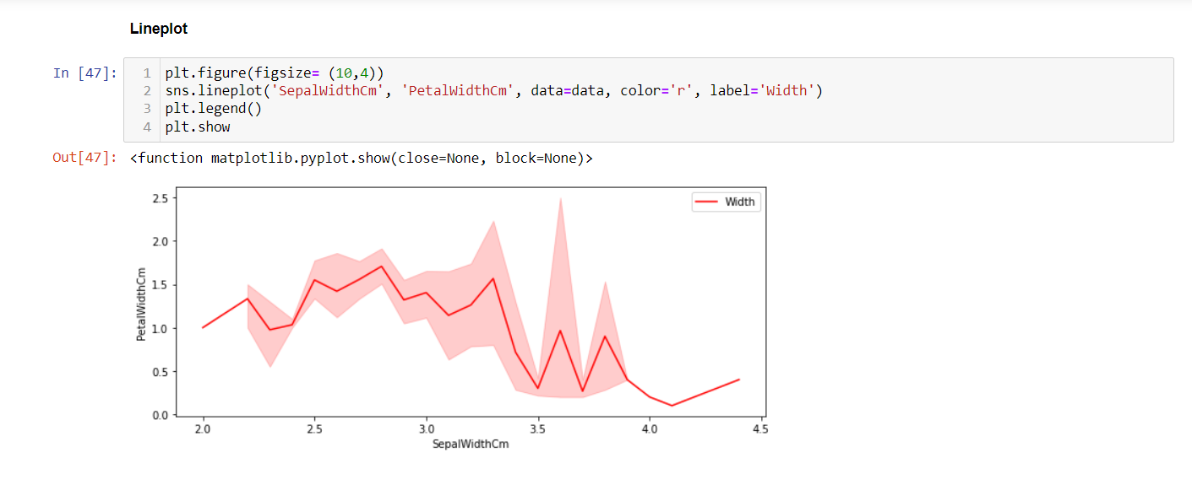
Continue…

Slide 21
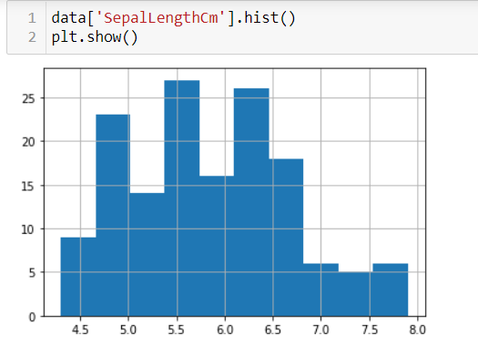
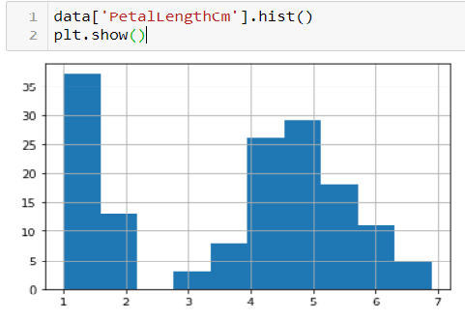
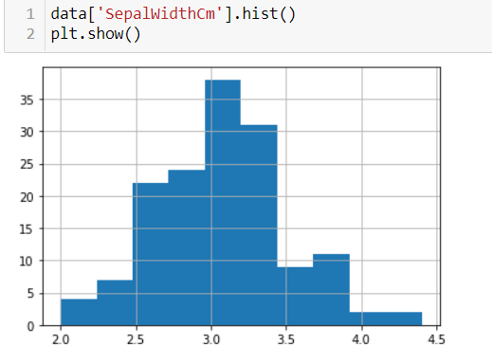
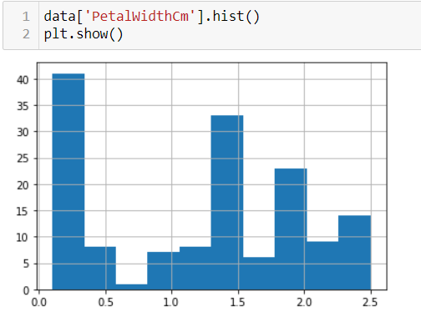
Continue…

Slide 22
Continue…
From the above plot, we can see that –
The highest frequency of the sepal length is between 30 and 35 which is between 5.5 and 6
The highest frequency of the sepal Width is around 70 which is between 3.0 and 3.5
The highest frequency of the petal length is around 50 which is between 1 and 2
The highest frequency of the petal width is between 40 and 50 which is between 0.0 and 0.5

Slide 23
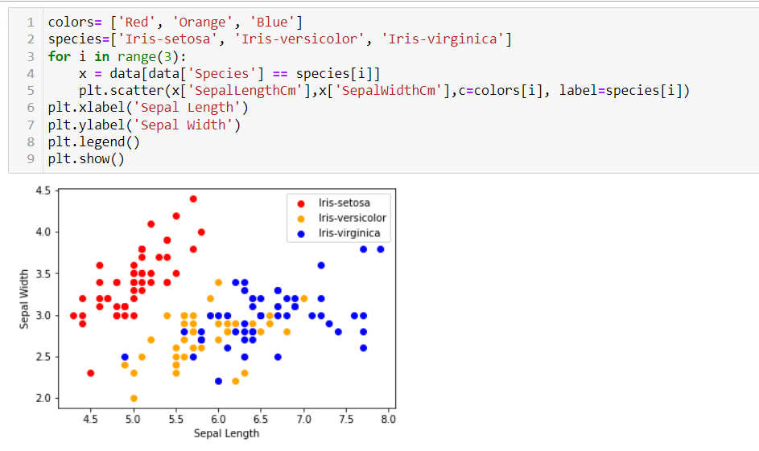
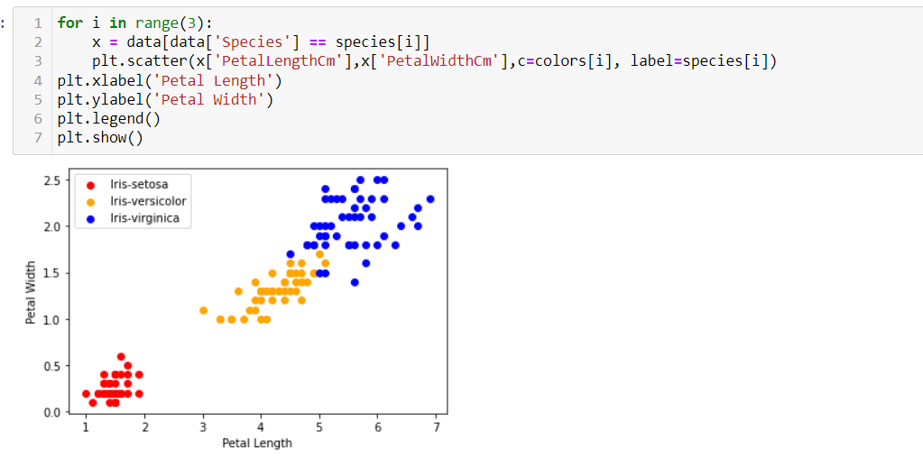
Continue..

Slide 24
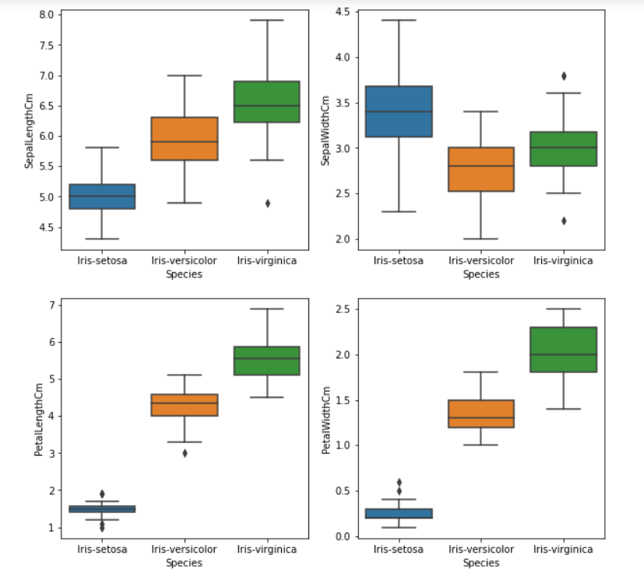
Continue…
Box Plots:-
We can use boxplots to see how the categorical value distributed with other numerical values.
From the above graph, we can see that –
Species Setosa has the smallest features and less distributed with some outliers.
Species Versicolor has the average features.
Species Virginica has the highest features.

Slide 25
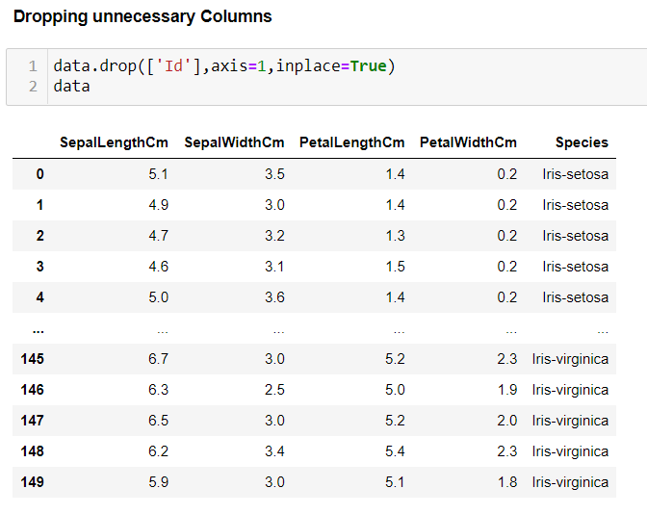
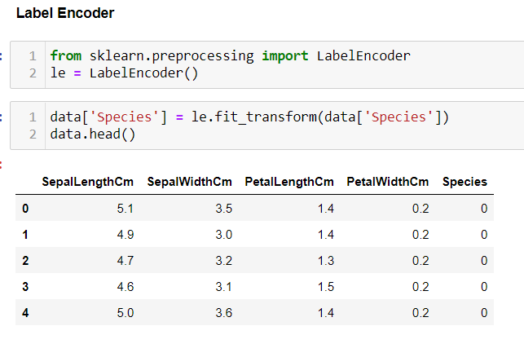
7.Preparing data for training model.

Slide 26
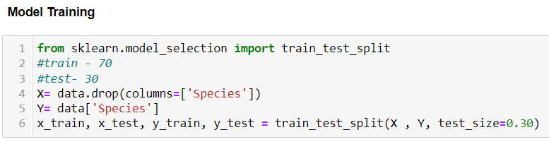
8. Split the data into train and test data.

Slide 27
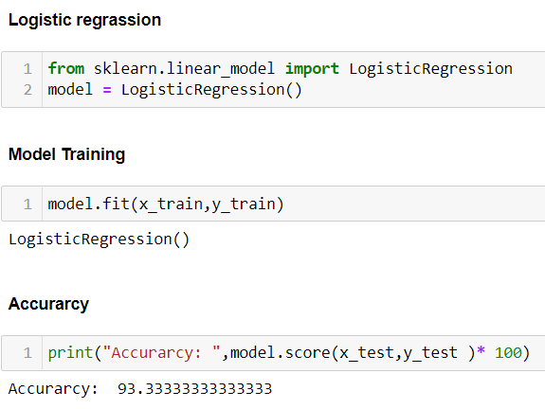
9. Use ML Algorithm
Logistic regression is a model that uses a logistic function to model a dependent variable.
Like all regression analyses, the logistic regression is a predictive analysis.
Logistic regression is used to describe data and to explain the relationship between one dependent variable and one or more nominal, ordinal, interval or ratio-level independent variables.

Slide 28
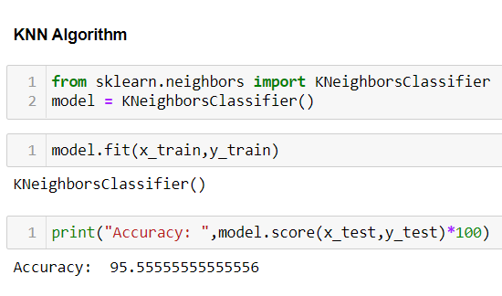
Continue
K-Nearest Neighbors is one of the most basic yet essential classification algorithms in Machine Learning.
It belongs to the supervised learning domain and finds intense application in pattern recognition, data mining.
KNN algorithm can also be used for regression problems.
The only difference will be using averages of nearest neighbors rather than voting from nearest neighbors.
KNN algorithm makes predictions by calculating similarity between the input sample and each training instance.

Slide 29
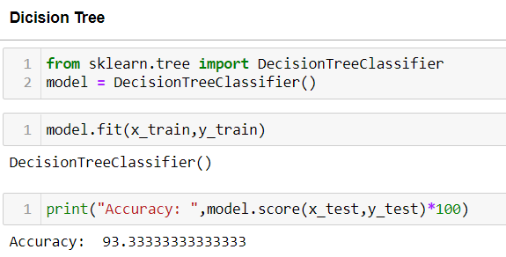
Continue…
A decision tree is a machine learning algorithm that uses a tree-like model of decisions and their subsequent consequences to arrive at a particular decision.
It is a Supervised Machine Learning model, where the data is continuously split according to a certain parameter, and finally, a decision is made.

Slide 30
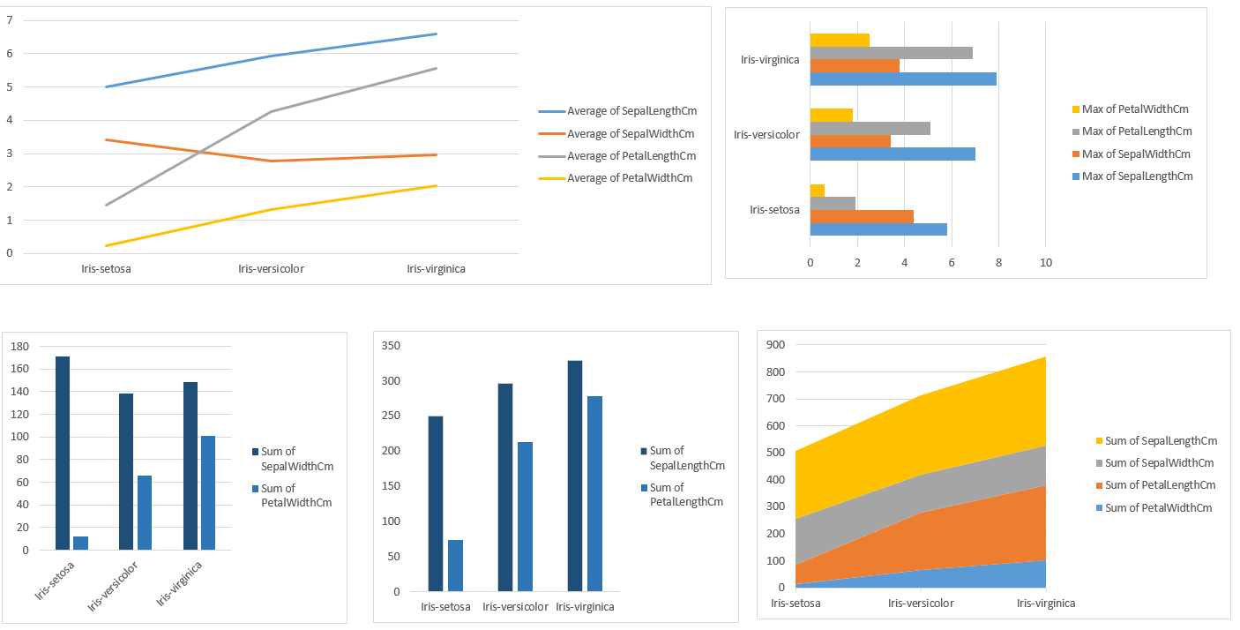
10. Dashboard

Slide 31
Reference
https://www.kaggle.com/datasets/uciml/iris

Slide 32
Thank You!!!!

